Slide 1
Chapter 1 – Architectural Design
Software Architecture and Design
Mutah University
Faculty of IT
Department of Software Engineering
Dr. Ra’Fat A. AL-Msie’Deen
rafatalmsiedeen@mutah.edu.jo

Slide 2
Reference - Text Book:
Chapter 6 of Software Engineering book - by Ian Sommerville. l0th Edition. Addison Wesley, 2015, ISBN-10: 0137035152.

Slide 3
Objectives
The objective of this chapter is to introduce the concepts of software architecture and architectural design. When you have read the chapter, you will:
understand why the architectural design of software is important;
understand the decisions that have to be made about the software architecture during the architectural design process;
have been introduced to the idea of Architectural patterns, well-tried ways of organizing software architectures that can be reused in system designs;
understand how Application-Specific Architectural patterns may be used in transaction processing and language processing systems.

Slide 4
Topics covered
Architectural design decisions
Architectural views
Architectural patterns
Application architectures

Slide 5
Architectural design
Architectural design is concerned with understanding how a software system should be organized and designing the overall structure of that system.
Architectural design is the critical link between design and requirements engineering, as it identifies the main structural components in a system and the relationships between them.
The output of the architectural design process is an architectural model that describes how the system is organized as a set of communicating components.

Slide 6
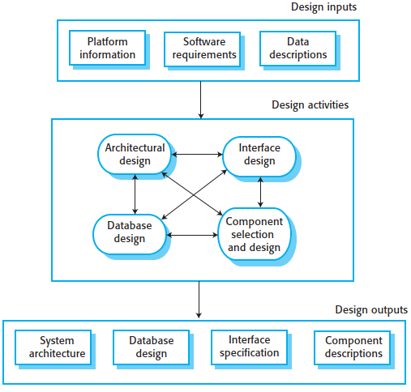
Architectural design … cont.
In the model of the software development process, architectural design is the first stage in the software design process.
Figure 0.
A general model of the design process.

Slide 7
Agility and architecture
In agile processes, it is generally accepted that an early stage of an agile development process should focus on designing an overall system architecture.
Incremental development of architectures is not usually successful. Refactoring components response to changes is usually relatively easy. However, refactoring the system architecture is expensive because you may need to modify most system components to adapt them to the architectural changes.

Slide 8
Agility and architecture … cont.
In practice, there is a significant overlap between the processes of requirements engineering and architectural design.
Ideally, a system specification should not include any design information. This ideal is unrealistic, however, except for very small systems.
You need to identify the main architectural components as these reflect the high-level features of the system.
Therefore, as part of the requirements engineering process, you might propose an abstract system architecture where you associate groups of system functions or features with large-scale components or sub-systems.
You then use this decomposition to discuss the requirements and more detailed features of the system with stakeholders.

Slide 9
The architecture of a packing robot control system
To help you understand what I mean by system architecture, look at Figure 1. This diagram shows an abstract model of the architecture for a packing robot system.
This robotic system can pack different kinds of objects.
It uses a vision component to pick out objects on a conveyor, identify the type of object, and select the right kind of packaging.
The system then moves objects from the delivery conveyor to be packaged. It places packaged objects on another conveyor.
The architectural model shows these components and the links between them.

Slide 10
The architecture of a packing robot control system … cont.

Slide 11
Architectural abstraction
You can design software architectures at two levels of abstraction, which I call architecture in the small and architecture in the large:
Architecture in the small is concerned with the architecture of individual programs.
At this level, we are concerned with the way that an individual program is decomposed into components.
This chapter is mostly concerned with program architectures.

Slide 12
Architectural abstraction … cont.
You can design software architectures at two levels of abstraction, which I call architecture in the small and architecture in the large:
Architecture in the large is concerned with the architecture of complex enterprise systems that include other systems, programs, and program components.
These enterprise systems may be distributed over different computers, which may be owned and managed by different companies.

Slide 13
Architectural abstraction … cont.
Software architecture is important because it affects the performance, robustness, distributability, and maintainability of a system.
Individual components implement the functional system requirements, but the dominant influence on the non-functional system characteristics is the system’s architecture.
Chen et al. confirmed this in a study of “architecturally significant requirements” where they found that non-functional requirements had the most significant effect on the system’s architecture.

Slide 14
Advantages of explicit architecture
Bass et al. suggest that explicitly designing and documenting software architecture has three advantages:
Stakeholder communication
The architecture is a high-level presentation of the system that may be used as a focus for discussion by a range of different stakeholders.

Slide 15
Advantages of explicit architecture … cont.
System analysis
Making the system architecture explicit at an early stage in the system development requires some analysis.
Architectural design decisions have a profound effect on whether or not the system can meet critical requirements such as performance, reliability, and maintainability.

Slide 16
Advantages of explicit architecture … cont.
Large-scale reuse
An architectural model is a compact, manageable description of how a system is organized and how the components interoperate.
The architecture may be reusable across a range of systems.
The system architecture is often the same for systems with similar requirements and so can support large-scale software reuse.
Product-line architectures may be developed.
Product-line architectures are an approach to reuse where the same architecture is reused across a range of related systems.

Slide 17
Architectural representations
Simple, informal block diagrams showing entities and relationships are the most frequently used method for documenting software architectures.
But these have been criticised because they lack semantics, do not show the types of relationships between entities nor the visible properties of entities in the architecture.
Depends on the use of architectural models. The requirements for model semantics depends on how the models are used.

Slide 18
Block diagram
System architectures are often modeled informally using simple block diagrams, as in Figure 1.
Each box in the diagram represents a component.
Boxes within boxes indicate that the component has been decomposed to subcomponents.
Arrows mean that data and or control signals are passed from component to component in the direction of the arrows.

Slide 19
Block diagram … cont.
Block diagrams present a high-level picture of the system structure, which people from different disciplines, who are involved in the system development process, can readily understand.
In spite of their widespread use, Bass et al. dislike informal block diagrams for describing an architecture.
They claim that these informal diagrams are poor architectural representations, as they show neither the type of the relationships among system components nor the components’ externally visible properties.

Slide 20
Block diagram … cont.
Very abstract - they do not show the nature of component relationships nor the externally visible properties of the sub-systems.
However, useful for communication with stakeholders and for project planning.

Slide 21
Block diagram … cont.
Block diagrams are a good way of supporting communications between the people involved in the software design process. They are intuitive, and domain experts and software engineers can relate to them and participate in discussions about the system.
Managers find them helpful in planning the project. For many projects, block diagrams are the only architectural description.

Slide 22
Use of architectural models
The apparent contradictions between architectural theory and industrial practice arise because there are two ways in which an architectural model of a program is used:
As a way of facilitating discussion about the system design.
As a way of documenting an architecture that has been designed.

Slide 23
Use of architectural models … cont.
As a way of facilitating discussion about the system design
A high-level architectural view of a system is useful for communication with system stakeholders and project planning because it is not cluttered with detail.
Stakeholders can relate to it and understand an abstract view of the system. They can then discuss the system as a whole without being confused by detail.
The architectural model identifies the key components that are to be developed so that managers can start assigning people to plan the development of these systems.

Slide 24
Use of architectural models … cont.
As a way of documenting an architecture that has been designed
The aim here is to produce a complete system model that shows the different components in a system, their interfaces and their connections.
The argument for such a model is that such a detailed architectural description makes it easier to understand and evolve the system.

Slide 25
Key points
A software architecture is a description of how a software system is organized.

Slide 26
Chapter 1 – Architectural Design
Software Architecture and Design
Mutah University
Faculty of IT
Department of Software Engineering
Dr. Ra’Fat A. AL-msie’deen
rafatalmsiedeen@mutah.edu.jo

